Slide 1
Implementation
Mapping Design to (C#/Java) Code
Notes:
2/6/17 - updated

Slide 2
Overview
At the end of this session, you will be able to:
Explain how the various UML models support software development
Map the various design class diagrams into a programming language such as C# or Java
Notes:
2/6/17 - updated

Slide 3
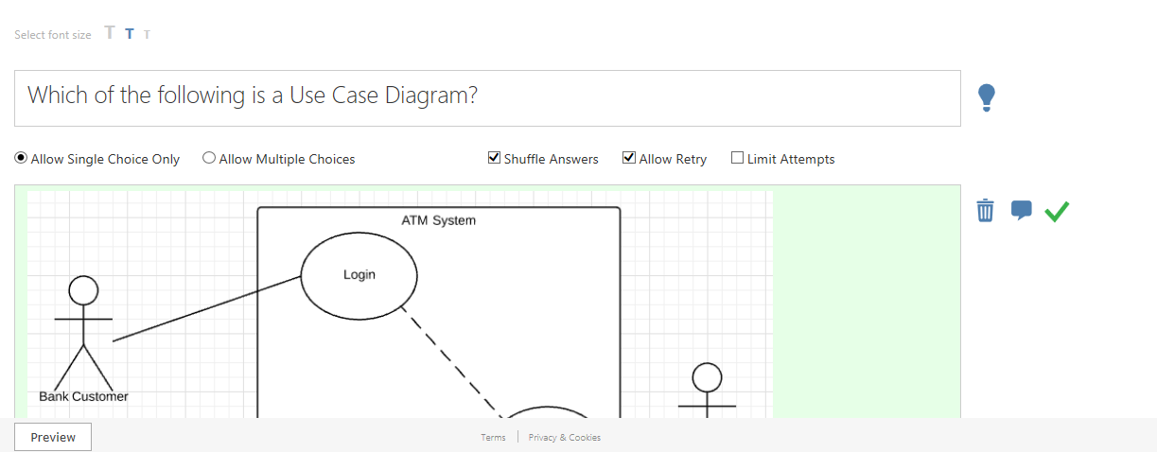
Recap
Notes:
2/6/17 - updated

Slide 4

Recap
Notes:
2/6/17 – updated

Slide 5
Various design models
There are various design models such as:
Use Case Diagram & Description
Domain Class Diagram
Sequence Diagram
Solution Class Diagram
Notes:
2/6/17 - updated

Slide 6
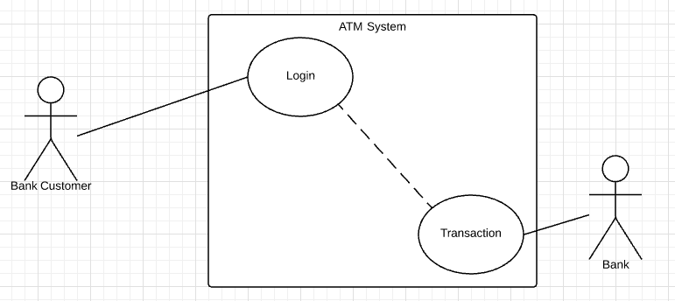
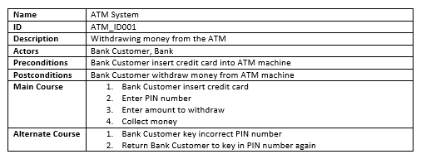
Use Case Model and Description
Model the system functional requirements and the various scenarios and process of each of the system functions.
Example: Use Case Description
Example: Use Case Diagram
Notes:
2/6/17 – updated

Slide 7
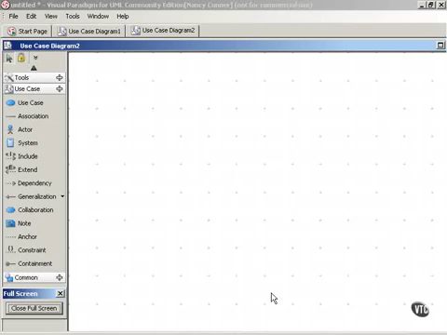
Video: Use Case Model
Source: rmb1905 (YouTube)
Notes:
Updated

Slide 8
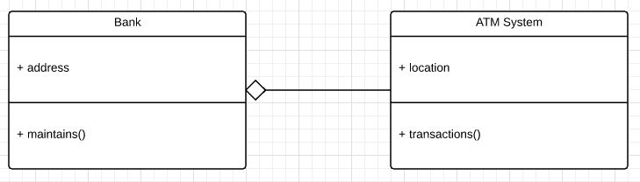
Domain Model (Domain Class Diagram)
Model the system domain objects that the system wants to track and their relations.
Example: Domain Class Diagram
Notes:
2/6/17 – updated

Slide 9
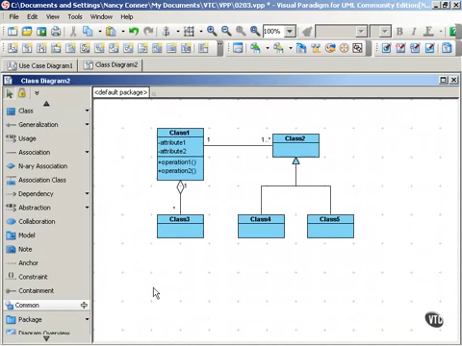
Video: Class Diagram
Source: rmb1905 (YouTube)

Slide 10
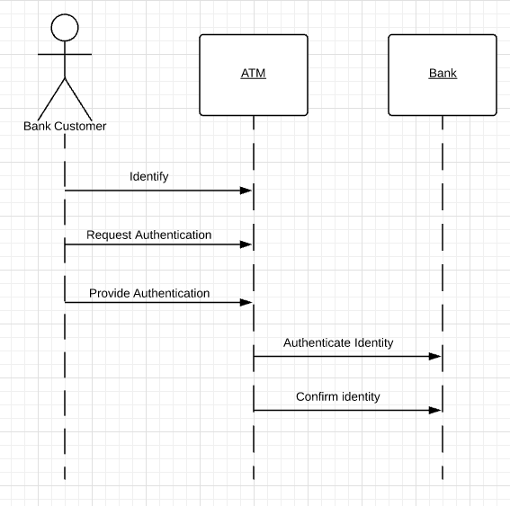
Sequence Diagram (Interaction diagram)
Model the interaction between the various system solution objects. This will help us derive the responsibilities of each of the solution objects.
Example: Sequence Diagram
Notes:
2/6/17 – updated

Slide 11
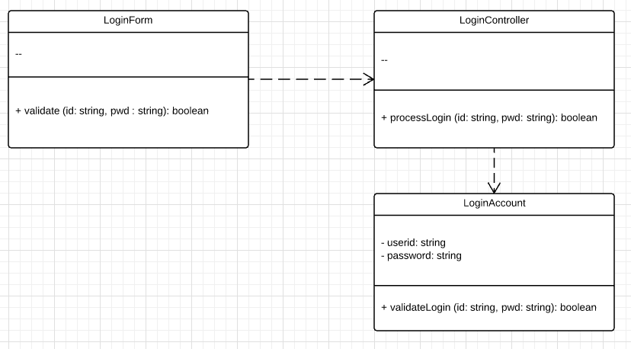
Design Model (Solution Class Diagram)
Model the system solution objects (i.e. the software components) which make up the system.
Example: Solution Class Diagram
Notes:
2/6/17 – updated

Slide 12
Quiz
Notes:
2/6/17 - updated

Slide 13
Quiz
Notes:
2/6/17 - updated

Slide 14
Focus: Relationships between Solution Classes
In this session, you will learn more about the different relationships between Solution Classes such as:
Inheritance
Bi-direction association
Uni-directional association
Aggregation
Composition
Notes:
2/6/17 - updated

Slide 15
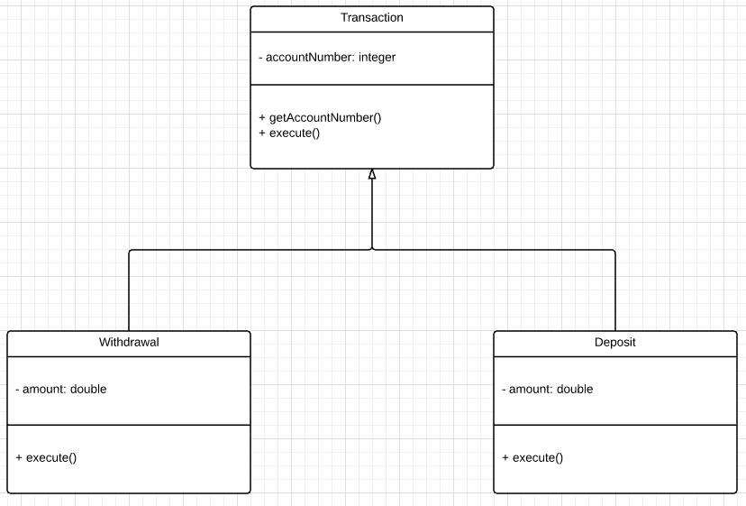
Relationships between Solution classes - Inheritance
Inheritance simply means that one of the classes “inherit” the functionality of another class
Example:
Withdrawal class “inherit” execute() from execute() from Transaction class.
Notes:
2/6/17 - updated

Slide 16
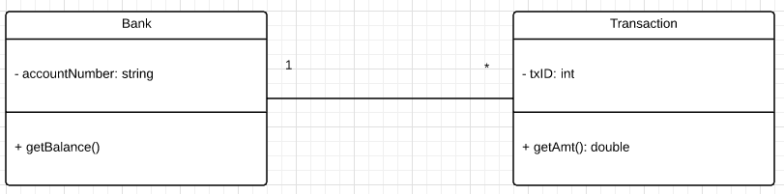
Relationships between Solution classes - Bi-direction association
Association are always assumed to be bi-directional; that means that both classes are aware of each other and their relationship unless you qualify the classes as some other types.
Example:
On Bank class, one bank account could have multiple transaction
Notes:
2/6/17 - updated

Slide 17
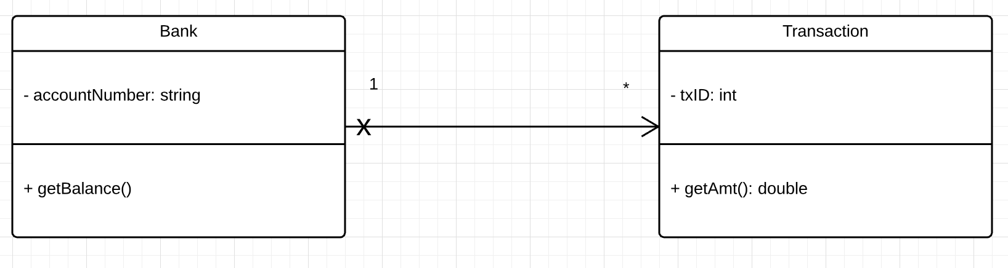
Relationships between Solution classes - Uni-directional association
Uni-directional association is similar to Bi-directional association.
The difference is that there is arrow head between each class so that one object will “know” about the other object of another class.
Notes:
2/6/17 - updated

Slide 18
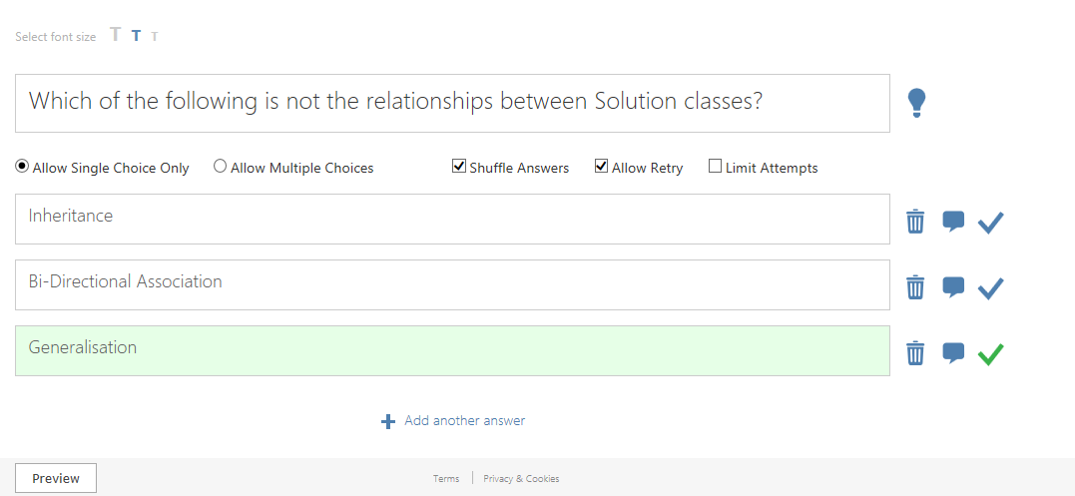
Quiz
Notes:
2/6/17 - updated

Slide 19
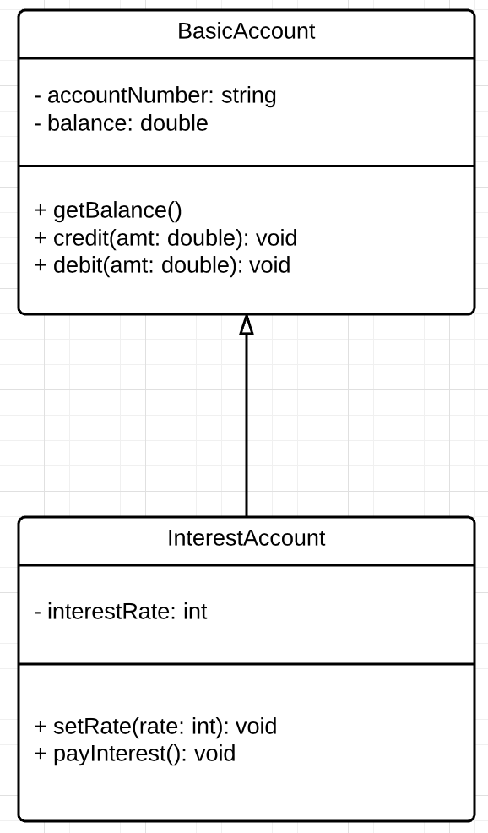
Mapping a solution class
Mapping and coding an individual solution class to a corresponding Java or C# class is fairly straightforward.
In the solution class diagram shown the right,
BasicAccount is the base, super or base class
Has 2 attributes and 3 operations
InterestAccount is the child, sub or derived class
Has 1 attribute and 2 operations
Notes:
3/6/17 – updated
With animation

Slide 20
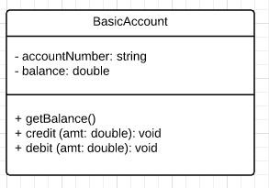
Mapping a solution class to C#
public class BasicAccount {
private string accountNumber;
private double balance;
public double getBalance() {
…
}
public void credit(double amt) {
…
}
public void debit(double amt) {
…
}
}
Notes:
3/6/17 – updated
With animation

Slide 21
Mapping a solution class to Java
Mapping a solution class to Java is similar to mapping a solution class to C#
public class BasicAccount
{
private String accountNumber;
private double balance;
public void getBalance()
{ … }
public void credit(double amt)
{ … }
public void debit(double amt)
{ … }
}

Slide 22
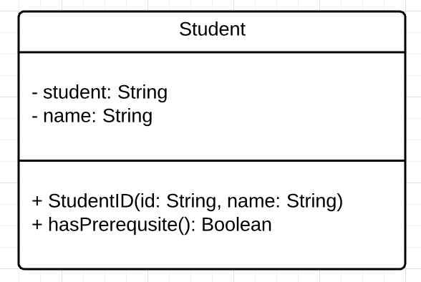
Task 1: Map the following Student solution class to a C# class template
Notes:
3/6/17 - updated

Slide 23
Mapping Inheritance
Using the diagram on the right for example, in order to map the InterestAccount class, we will have to map the inheritance relationship too.

Slide 24
Mapping Inheritance in C#
Public class InterestAccount : BasicAccount
{
private int interestRate;
public void setRate(int rate)
{ … }
public void payInterest()
{ … }
}
In C#, we will use “:” to indicate inheritance relationship between two classes

Slide 25
Mapping Inheritance in Java
Public class InterestAccount extends BasicAccount
{
private int interestRate;
public void setRate(int rate)
{ … }
public void payInterest()
{ … }
}
In Java, we will use “extends” to indicate inheritance relationship between two classes

Slide 26
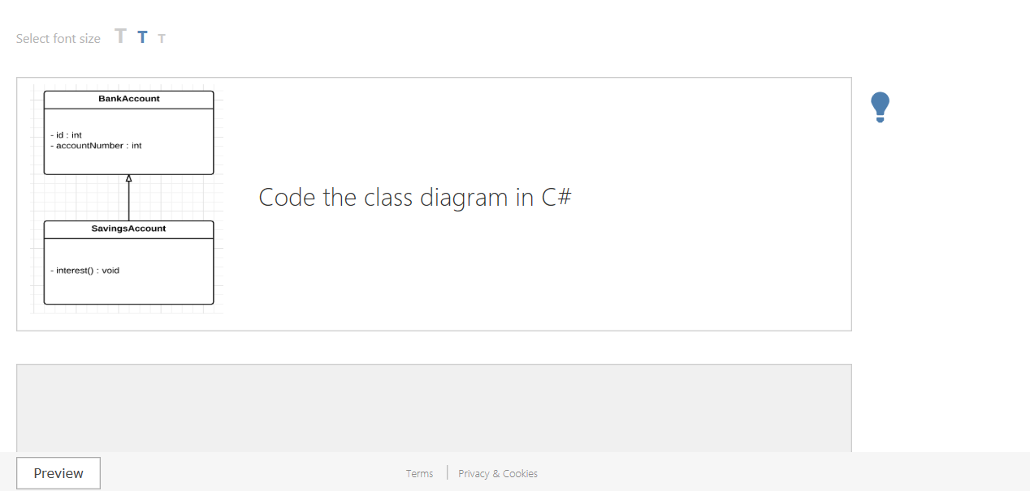
Quiz

Slide 27
Quiz

Slide 28
Mapping associations
In C#, association in a solution class diagrams can be viewed as “Navigability”.
To handle the navigability from BasicAccount to Transaction, we need a reference to a list of Transaction declared in BasicAccount. Since the multiplicity is *, we will use Array Type in C# or ArrayList in Java.

Slide 29
Mapping Uni-directional (one to many) association (C#)
public class Bank
{
private string accountNumber;
private Transaction [] txList;
public double getBalance()
{ … }
}

Slide 30
Mapping Uni-directional (one to many) association (Java)
public class Bank
{
private string accountNumber;
private ArrayList<Transaction> [] txList;
public double getBalance()
{ … }
}

Slide 31
Mapping Bi-directional (one to many) association
Uni-directional association navigate only from the Bank object.
To find out which account the Transaction object belongs to, we got to use Bi-directional association.
For this to work, we will have to declare a reference to each other in each class.

Slide 32
Mapping Bi-directional (one to many) association (C#)
public class Bank
{
private string accountNumber;
private Transaction [] txList;
…
}
public class Transaction
{
private int txID;
…
private Bank Bnk;
}

Slide 33
Mapping Bi-directional (one to many) association (Java)
public class Bank
{
private string accountNumber;
private ArrayList<Transaction> txList;
…
}
public class Transaction
{
private int txID;
…
private Bank Bnk;
}

Slide 34
Task 2.0: Construct a class diagram using the code given
Java code:
public class Lecturer extends Staff
{
private ArrayList <Module> modList;
}
public class Module
{
private String moduleCode;
private Lecturertutor;
public boolean computeGrade() { … }
…
}

Slide 35
Task 2.1: Construct a class diagram using the code given
C# code:
public class Lecturer : Staff
{
private Module [ ] moduList;
….
}
public class Module
{
private string moduleCode;
private Lecturer tutor;
public boolean computeGrade() {… }
….
}

